Slide 1

Vel Tech Rangarajan Dr. Sagunthala R&D Institute of Science and Technology
School of Computing
Department of Computer Science and Engineering
10211CS224 / FULL STACK APPLICATION DEVELOPMENT (JAVA)
PROJECT REVIEW : MILESTONE PROJECT – 1
Date: 23-03-2026
AUTOMATED QUIZ ENGINE WITH PDF CERTIFICATION GENERATION
SDG: SDG 4 – Quality Education
Presented By:
G SRINIVASA ANIL KUMAR – VTU26558 – Reg.No 23UECS1097
Courses Handling Faculty:
Dr. ANGELINE LIDYA - Faculty

Slide 2
INTRODUCTION
The Automated Quiz Engine with PDF Certification Generation is a web-based platform that enables users to test their knowledge across multiple technical domains.
Traditional assessments are manual, time-consuming, and lack instant feedback — creating a gap in self-learning tools.
This project provides a fully automated quiz experience with topics like JavaScript, Python, Web Dev, Data Science, Cybersecurity, and General Knowledge.
Users can set the number of questions and time limits, answer MCQs, and receive a personalized PDF certificate upon successful completion.
The system uses the Claude AI API to dynamically generate quiz questions, ensuring variety and relevance for every session.
It aligns with SDG 4 (Quality Education) by making accessible, self-paced knowledge assessment available to learners globally.
1
2
3
4
5
6
7
8
9

Slide 3
PROBLEM STATEMENT
Most online learning platforms lack a smart, on-demand quiz system that can generate questions dynamically and certify learners instantly.
Existing quiz tools use static question banks that become predictable and do not adapt to different difficulty levels or topics effectively.
There is no automated way for learners to receive a proof of accomplishment (certificate) immediately after completing an assessment online.
This project solves these problems by using AI to auto-generate unique quiz questions per session and automatically produce a personalized PDF certificate on quiz completion.
1
2
3
4
5
6
7
8
9

Slide 4
OBJECTIVE(S)
To design and develop an AI-powered automated quiz engine that dynamically generates multiple-choice questions across six technical topics using the Claude API.
To implement an automated PDF certificate generation system that rewards users with a personalized, downloadable certificate upon achieving a qualifying score in the quiz.
To improve learner engagement with a timed quiz interface, real-time feedback, score tracking, and topic-wise performance evaluation.
To evaluate performance of the system in generating accurate, contextually relevant quiz questions across varying difficulty levels and diverse technical domains.
1
2
3
4
5
6
7
8
9

Slide 5
PROPOSED SYSTEM
An AI-powered web application that auto-generates unique MCQs using Claude API based on selected topic and count.
Six quiz topics: JavaScript, Python, Web Dev, Data Science, Cybersecurity, General Knowledge.
Configurable number of questions and per-question timer for realistic exam simulation.
Instant result display with score, answers, and explanations after completion.
Automated downloadable PDF certificate generated using jsPDF on quiz success.
Fully automated end-to-end: no static question banks or manual certificate issuance needed.
1
2
3
4
5
6
7
8
9

Slide 6
PROPOSED SYSTEM ARCHITECTURE
System Architecture Overview:
Explain:
Input: User selects topic, enters name, sets question count and time per question.
Processing: Claude AI API generates MCQs; frontend handles timer, scoring, and answer validation.
Database: No persistent DB — questions generated dynamically per session via API calls.
Output: Score summary page + personalized PDF certificate generated and downloaded via jsPDF.
1
2
3
4
5
6
7
8
9

Slide 7
WORKFLOW
Workflow / Data Flow:
Step 1: User opens the web app, enters their name and selects a quiz topic.
Step 2: User configures quiz settings (number of questions, time per question) and clicks Start Quiz.
Step 3: Frontend sends API request to Claude — Claude returns JSON with questions, options, and correct answers.
Step 4: Quiz engine renders questions one-by-one with countdown timer; user selects answers.
Step 5: On completion, score is calculated and displayed; if passing score achieved, PDF certificate is auto-generated and downloaded.
1
2
3
4
5
6
7
8
9

Slide 8
TECHNOLOGIES USED
Frontend: HTML5, CSS3, JavaScript (Vanilla JS) — Responsive UI with dark theme, topic cards, timer, and quiz flow.
Backend: Anthropic Claude AI API (claude-sonnet model) — Dynamically generates MCQs in JSON format via REST API calls.
Database: None — Stateless design; all quiz data is generated dynamically per session with no persistent storage required.
Tools: jsPDF (PDF certificate generation), VS Code (IDE), Git & GitHub (version control), Live Server (local testing).
Hardware/Software Requirements: Any modern web browser (Chrome/Firefox/Edge), Internet connection for API calls, OS: Windows/macOS/Linux.
1
2
3
4
5
6
7
8
9

Slide 9
MODULE DESCRIPTION
Module 1: Topic Selection & Configuration
Allows users to enter their name, choose from 6 quiz topics, set number of questions (5/10/15/20), and configure time per question.
Module 2: AI Question Generation
Sends a structured prompt to the Claude API and receives dynamically generated MCQs in JSON format with 4 options and correct answers.
Module 3: Quiz Engine & Scoring
Renders questions with countdown timer, validates selected answers, highlights correct/incorrect responses, and calculates final score.
Module 4: PDF Certificate Generation
Uses jsPDF library to generate a personalized, styled certificate with user name, topic, score percentage, and date — auto-downloaded on quiz success.
1
2
3
4
5
6
7
8
9

Slide 10
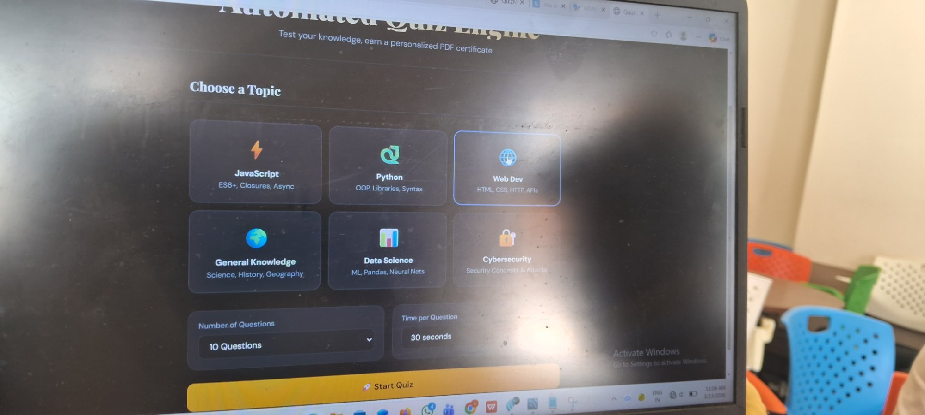
IMPLEMENTATION SCREENSHOTS
1
2
3
4
5
6
Screenshot 1: Topic Selection Page
The home screen of the Automated Quiz Engine — users choose a topic (JavaScript, Python, Web Dev, Data Science, Cybersecurity, General Knowledge), select the number of questions, and set the time per question before starting the quiz.
7
8
9

Slide 11
IMPLEMENTATION SCREENSHOTS
1
2
3
4
5
6
Screenshot 2: Quiz In Progress
Active quiz session showing a timed MCQ question. The countdown timer is visible, answer options are highlighted on selection, and the user can navigate through questions with instant visual feedback.
7
8(A)
9

Slide 12
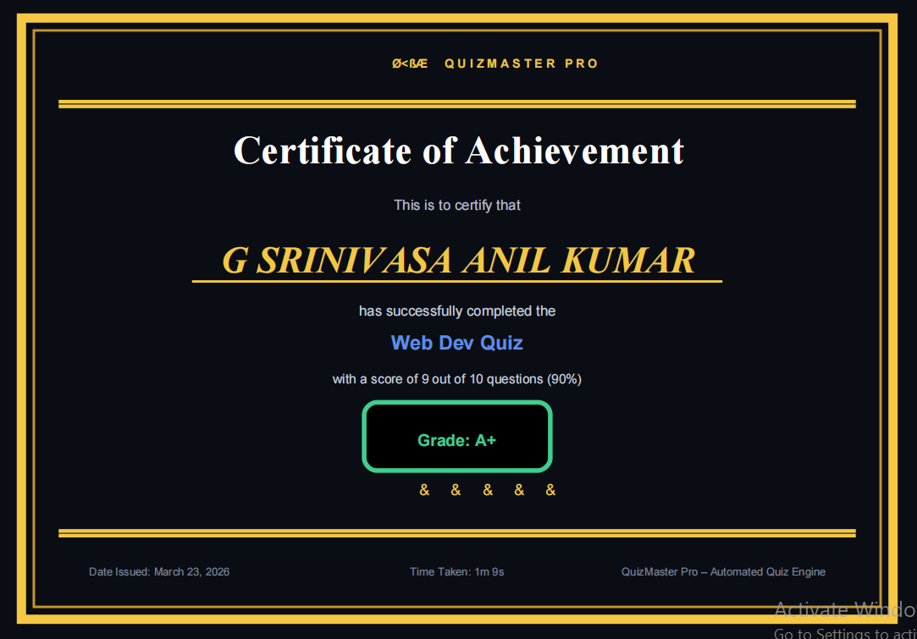
IMPLEMENTATION SCREENSHOTS
Screenshot 3: Quiz Results Page
Results screen showing the user's final score, percentage, correct vs incorrect answers breakdown, and detailed explanations for each question — helping users understand mistakes and learn effectively.
1
2
3
4
5
6
7
8(B)
9

Slide 13
ADVANTAGES & LIMITATIONS
ADVANTAGES
Dynamic AI question generation ensures fresh, unique questions every session — no repetition.
Instant PDF certificate generation eliminates manual issuance and provides immediate gratification.
Fully browser-based — no installation required; accessible from any device with internet.
Configurable question count and timer supports varied difficulty levels and learning needs.
Covers 6 diverse technical topics, making it a versatile self-assessment tool for CS students.
LIMITATIONS
Requires active internet connection — offline mode not supported as questions depend on the Claude API.
API latency may cause slight delays during question loading, especially under high traffic.
No user authentication or progress tracking — quiz history is not persisted across sessions.
Certificate generation is purely cosmetic — not linked to any institutional verification system.
API usage cost may limit scalability for large-scale deployment without a backend proxy.
1
2
3
4
5
6
7
8
9

Slide 14
Thank you

